Slide 1
ANUDIP DAP BATCH- DAP-D0293
PRESENTED BY: MUSKAN PEERZADE
TITLE: “UDEMY COURSES DATA ANALYSIS
UNDER THE GUIDANCE OF: Mrs. LEKSHMY MENON
DATE: 31/01/2025

Slide 2
Contents
OBJECTIVE 1
DATA OVERVIEW 2
METHODOLOGY 5
VISUALIZATIONS 6
CONCLUSION 8

Slide 3

“UDEMY COURSES DATA ANALYSIS”

Slide 4
OBJECTIVE:
Goal: To analyze data on Udemy courses and derive insights on:
Popular categories
Pricing trends
Enrollment statistics
Ratings and reviews
1

Slide 5
Data Overview
Dataset Description:
Source: Udemy course listings
Key Features: Course title, category, price, number of students, rating, number of reviews
Tools Used: Python, Excel

Slide 6
The dataset contains the following columns:
course_id: Unique identifier for each course.
course_title: Title of the course.
is_paid: Indicates if the course is paid or free.
price: Price of the course (for paid courses).
num_subscribers: Number of students enrolled.
num_reviews: Number of reviews received.
num_lectures: Total number of lectures in the course.
level: Skill level targeted (e.g., All Levels, Beginner, Intermediate).
content_duration: Total duration of the course.
published_timestamp: Date and time of course publication.
subject: Subject category of the course.

Slide 7
Here are the insights extracted from the dataset:
Top Subjects by Course Count:
Web Development: 1,200 courses
Business Finance: 1,199 courses
Musical Instruments: 680 courses
Top Subjects by Total Enrollments:
Web Development: 7,980,572 students
Business Finance: 1,870,747 students
Graphic Design: 1,063,148 students
Observation: Web Development attracts the highest number of students.
Correlation Between Reviews and Enrollments: A strong positive correlation of 0.65, indicating that courses with more reviews often have higher enrollments.
4. Distribution of Course Levels:
All Levels: 1,932 courses
Beginner Level: 1,271 courses
Intermediate Level: 421 courses
Expert Level: 58 courses

Slide 8
METHODOLOGY
Steps Taken:
Data Exploration: Identified trends in pricing, popularity, and engagement
Visualization: Created graphs and charts for better insights
Identified all different subjects for which Udemy is offering Courses?
Identified which subjects has the maximum number of courses
Displayed all the Courses which are free of cost & paid
Found out Which are Top selling Courses & least selling courses?
Displayed all the Courses of Graphic Design where the price is below 100?
Listed out all the courses that are related with 'Python’
Displayed the courses which are published in 2015
Identified What are the Maximum Number Of Subscribers for each level of Courses?

Slide 9
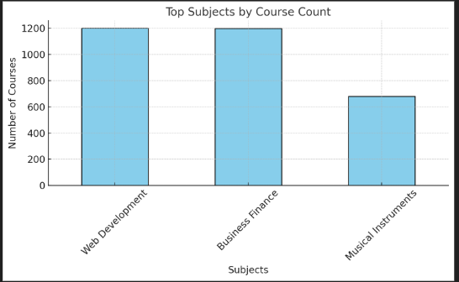
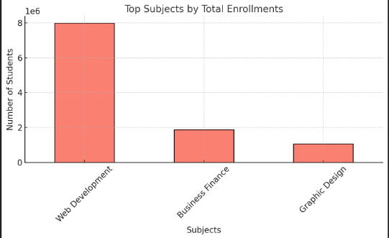
VISUALIZATIONS

Slide 10
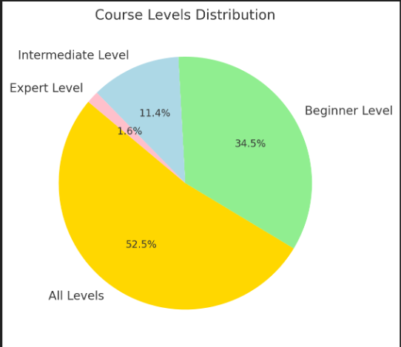
VISUALIZATIONS

Slide 11
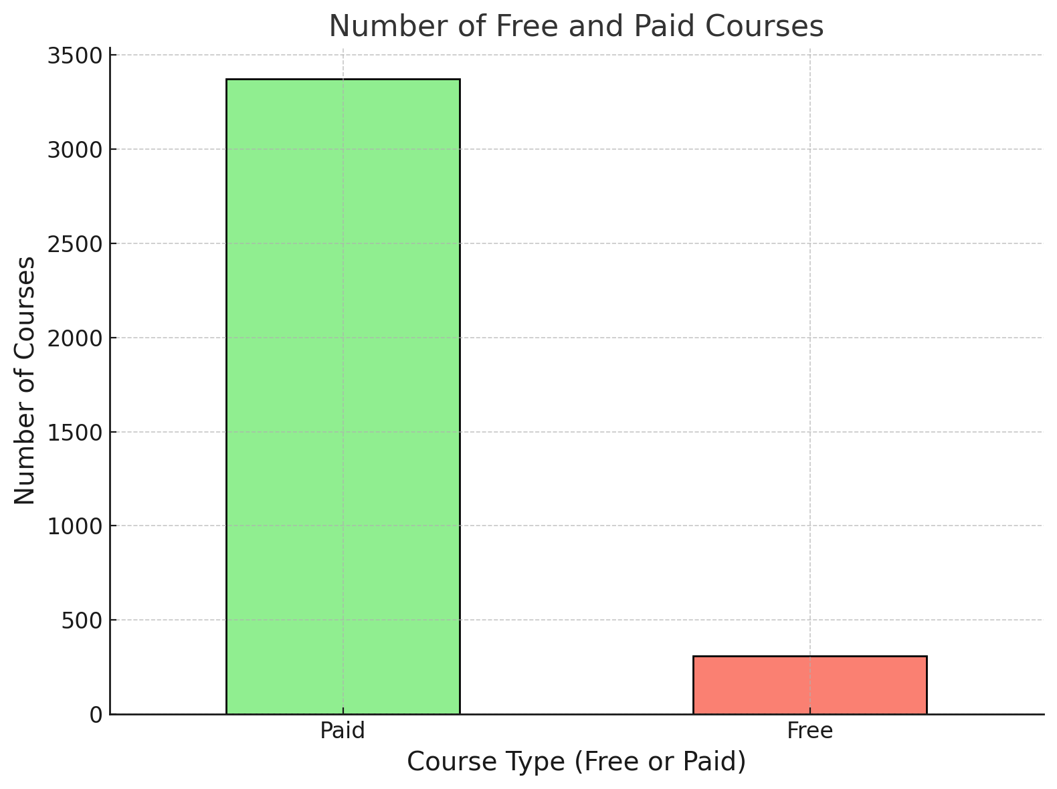
VISUALIZATIONS

Slide 12
CONCLUSION
Summary:
Web Development and Business Finance dominate as top subjects.
Affordable courses are more popular.
High reviews correlate with higher enrollments.
Future Scope:
Analyzing student demographics
Studying course completion rates

Slide 13
Thank you
Muskan Peerzade
7975365477
muskanconnectwork@gmail.com

